Slide 1
電子電路入門導論 其它常用電路
成功大學資訊工程系
蘇文鈺
此資料圖片取自網路

Slide 2
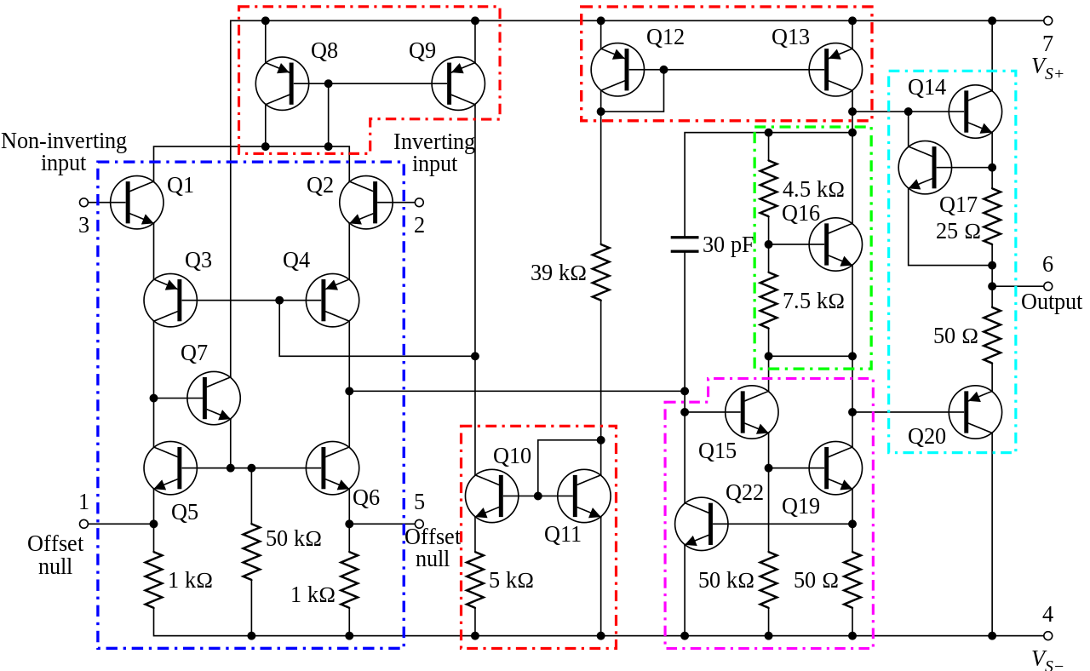
OP 放大器中常用基礎電路
由 Daniel Braun - redrawn png file (from User:Omegatron),Page# 4 of datasheet, CC BY 2.5, https://commons.wikimedia.org/w/index.php?curid=2205381
741運算放大器內部電路。虛線框：鏡像電流源 (紅)；差分放大器 (藍)；A類增益級 (品紅)；電壓電平轉換器 (綠)；輸出級 (青).

Slide 3
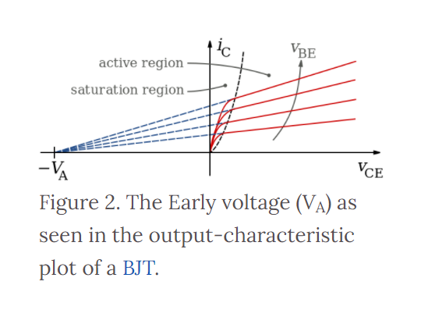
Early Effect
Though hfe is the ratio between Ic and Ib, it may not be a constant when Vcb becomes larger. The figure shows a typical characteristics of a BJT.
If we consider the collector of a BJT as the output, the output impedance see from the position of the collector is no longer infinite (Infinite output impedance of a current source is desired.).
The output impedance is (Vce+VA)/Ic. The ideal case happens when VA is Infinite.
https://www.wikiwand.com/en/Early_effect

Slide 4
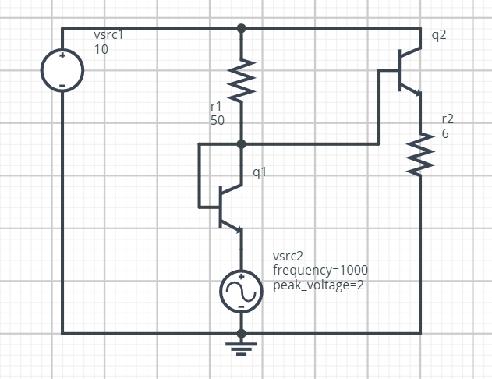
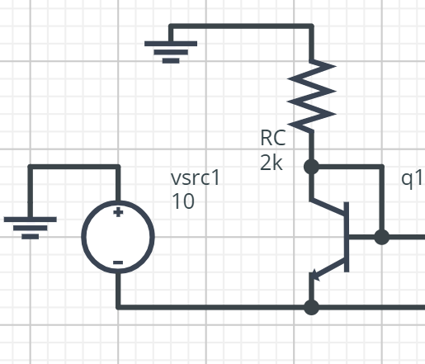
Use of a transistor to create a somewhat stable current supply
It doesn’t matter when we change of position of the power supply.
The driver stage of the upper half
Of the push-pull stage.

Slide 5
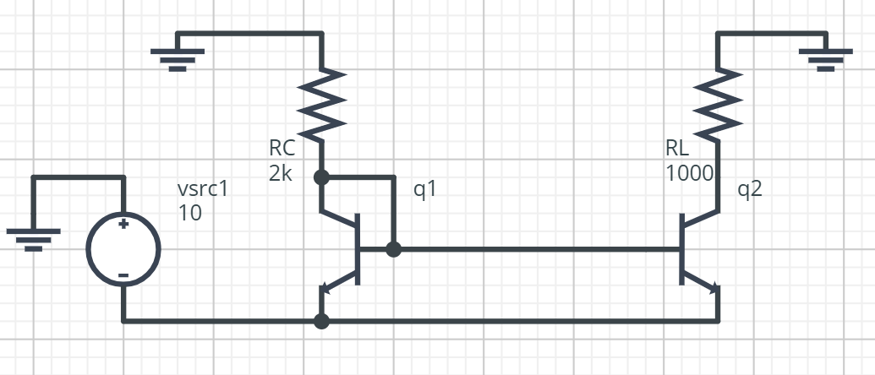
Current Mirror/Source 1 using NPN transistor
When RL is equal to Rc, the output current will be somewhat smaller the Ic of q1.
RL cannot be larger than Rc unless q1 and q2 use different power supply.
When RL is smaller than Rc, the output current will be somewhat larger than Ic of q1.
https://www.wikiwand.com/en/Current_mirror

Slide 6
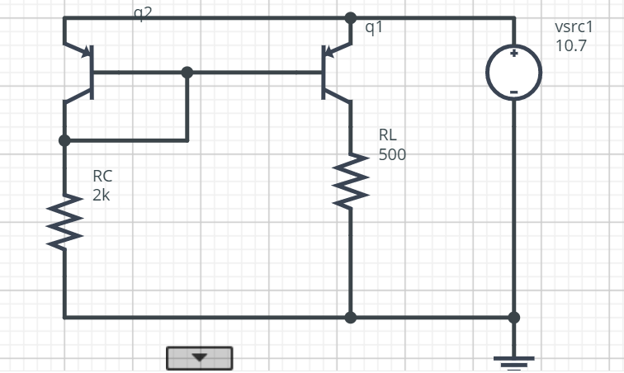
Current Mirror/Source 2 Using PNP BJT
As we can see in 741, one usually needs to have complementary current mirror to maintain a standard current.
In 741, the differential input stage also contains a current source which adds emitter resistors in order to increase the output impedance of the current source. It is a modified current source by Wilson.
It is noted that the two currents are not always equal.

Slide 7

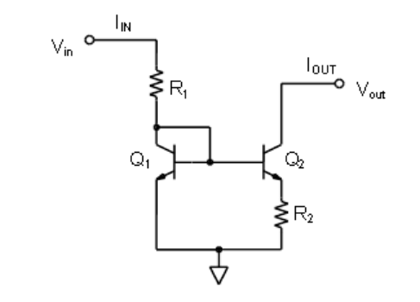
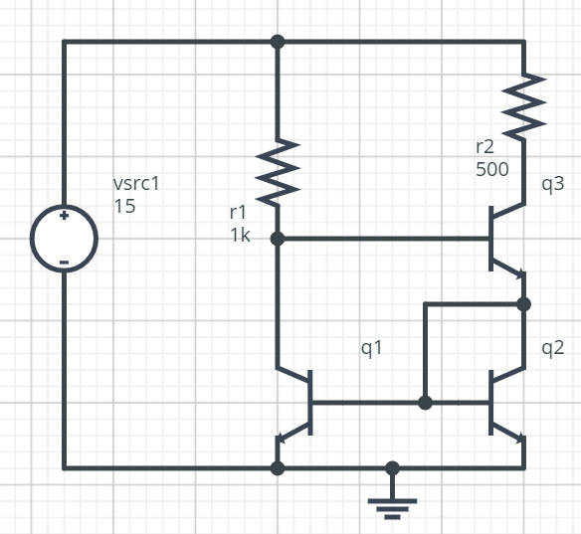
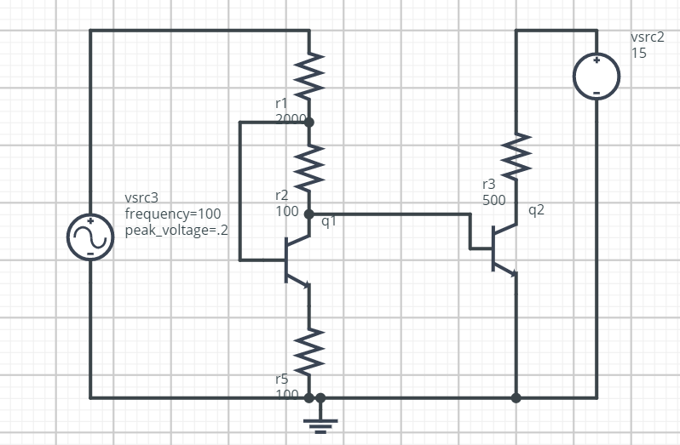
Wilson Current Mirror/Source NPN
To reduce the current gain error by adding one transistor.
If it is not close enough, one can add more transistors.
There are also other modification to the current mirror circuit. For the wildar version, one can now use RL larger than R1.
To stabilize the current source, one can add feedback
Please see ref with caution.
https://wiki.analog.com/university/courses/electronics/text/chapter-11

Slide 8
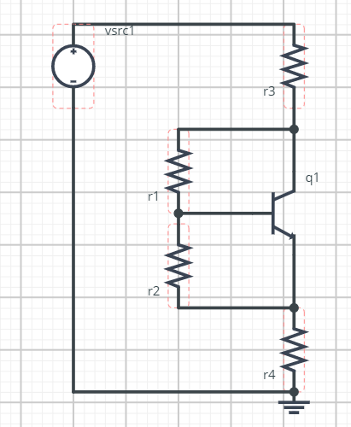
VBE Multiplier
In the PP Stage, one needs to bias the output transistors. Depending on the bias, the PP stage can operate at either class-A, class-AB or class-B modes.
In the previous loop, we use diodes and transistors to create the bias voltage. Thus, the bias voltage can only be multiples of VBE such that one cannot create precise bias voltage.
With VBE multiplier, it’seasily control the bias voltage.
However, one needs to be careful when choosing all the resistors.
r3/r4 is critical to the operating point of q1.
r1/r2 is critical to the Vce voltage, also in calculation.
http://cc.ee.nchu.edu.tw/~aiclab/teaching/Electronics3/lect14.pdf
https://en.wikipedia.org/wiki/Rubber_diode
https://paginas.fe.up.pt/~fff/eBook/MDA/Mult_Vbe.html

Slide 9
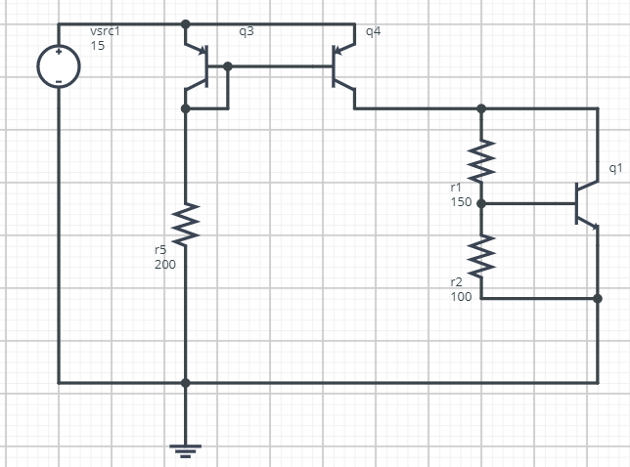
VBE Multiplier with Current Source
It isn’t convenient to control the current by using resistors in the previous circuit.
Instead of using resistors, a current source is applied which can easily supply the necessary current and provides an almost infinite output impedance.
One need to be careful. The Vce of q1 is usually not large and this implies that one need to carefully select q4 transistor if the supply voltage is large.

Slide 10
To create a high gain voltage amplifier
Why high gain is desired?
How to create a high gain voltage amplifier?
Very high Hfe
By using the circuit in Loop #2, very high Rc/Re is desired for a common emitter configuration.
Very high Rf/Ri is desired for a OPA circuit.
How infinite (Almost) gain is achieved in an OPA?
Combine very high Hfe and very high Rc/Re ratio.
See the 741 circuit.
Use of a Darlington configuration to achieve high hfe.

Slide 11
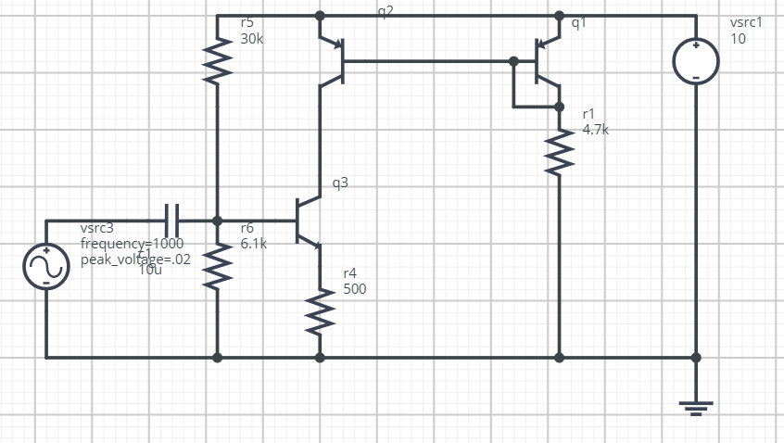
Infinite output Impedance of a circuit
An ideal current source has the infinite output impedance.
Though in practice, it isn’t infinite due to Early effect mentioned before. It is however larger enough.
Problem of the circuit in the right.
The current flowing through q3 is supplied by the current source and is determined by r1.
The current flowing through q3 is also determined by the bias condition of q3.
Make them equal.
What if they are not equal?

Slide 12
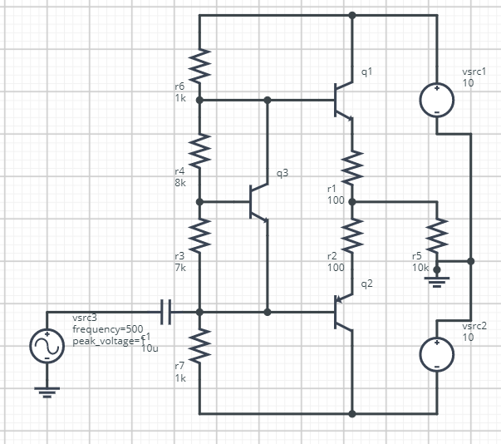
Application of VBE Multiplier in the PP Stage

Slide 13
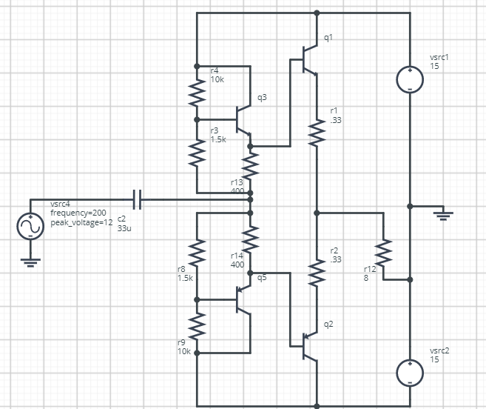
For symmetric circuitry
Noted that this is not the common
application of VBE multipliers.

Slide 14
Can you design a PP stage which combines current sources and VBE multipliers?

Slide 15
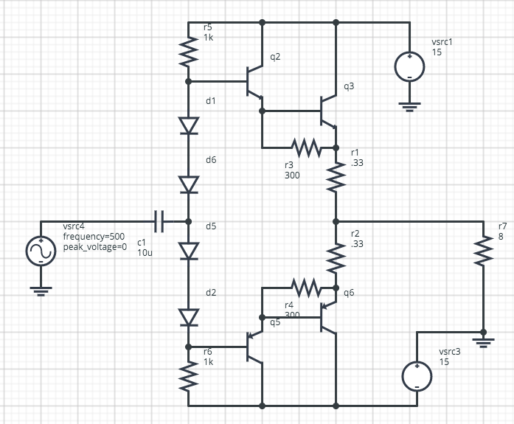
Darlington PP Stage

Slide 16
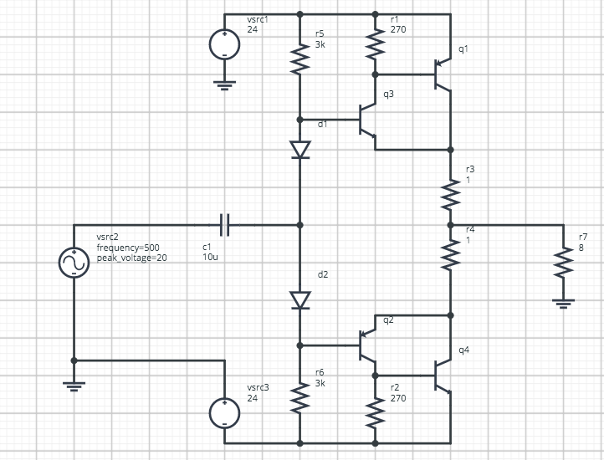
Compound PP Stage

Slide 17
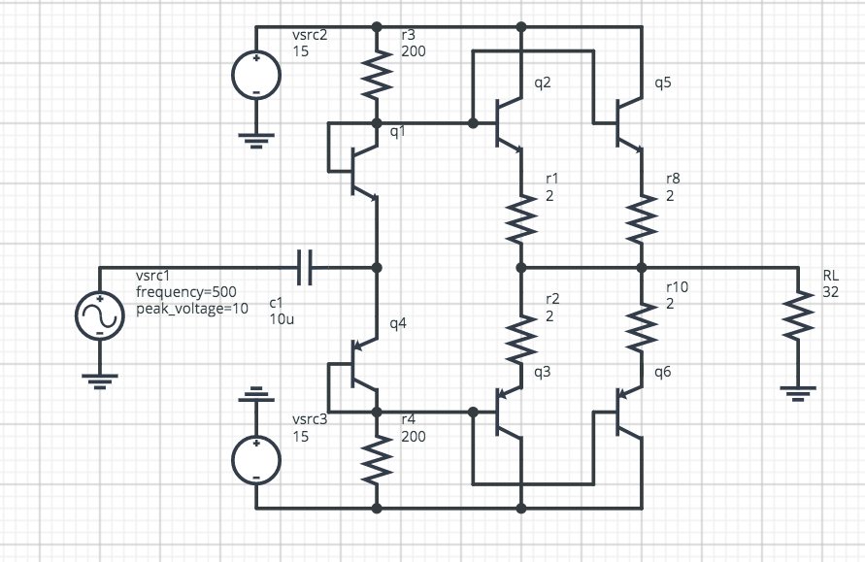
Parallel PP Stage

Slide 18
電路設計時注意要點
靜態功率
Class-A and Class-AB
功率晶體
驅動晶體
電阻
增益與頻率響應
最大擺幅
偏壓越深可以達到越大擺幅(失真減少)
偏壓越深，靜態功率越大(發熱高)
失真
交越crossover失真
偏壓越深，失真越小
截波Clipping失真
不可能達到電源Vcc/Vee
負載
負載阻抗越高越容易驅動
偏壓需要隨負載調整
注意輸出與輸入阻抗，並注意與自己連接的電路的輸出輸入阻抗

Slide 19
Quiz(下週)：
Current source與VBE Multiplier 的混合題(P.9)
計算各晶體的VCE and IC
計算各電阻的靜態功率

Slide 20
實做(下下周)
實做P.12的電路
負載100歐姆
輸出級晶體設級電阻為10歐姆
請備妥材料
BC327/337，TIP31/32 若干
可變電阻與電容若干個
以你認為適當的數值為準
其他必備材料

Slide 21
測驗（下下週）
基於Quiz更為深入的計算問題
Current Mirror與VBE Multiplier的變形(請參考PPT提供的資料連結)
High Gain Amplifier的設計

